Slide 1
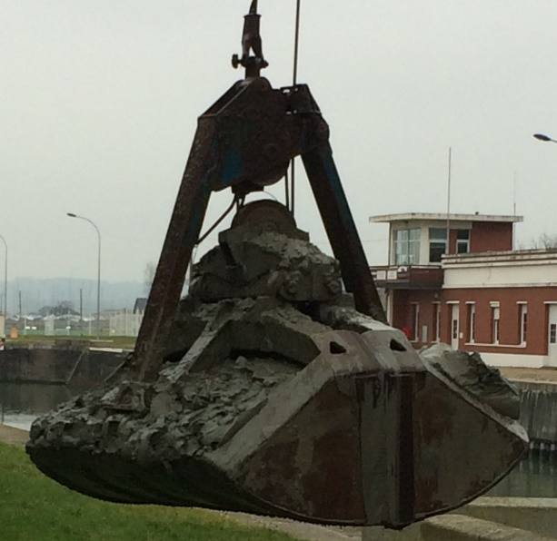
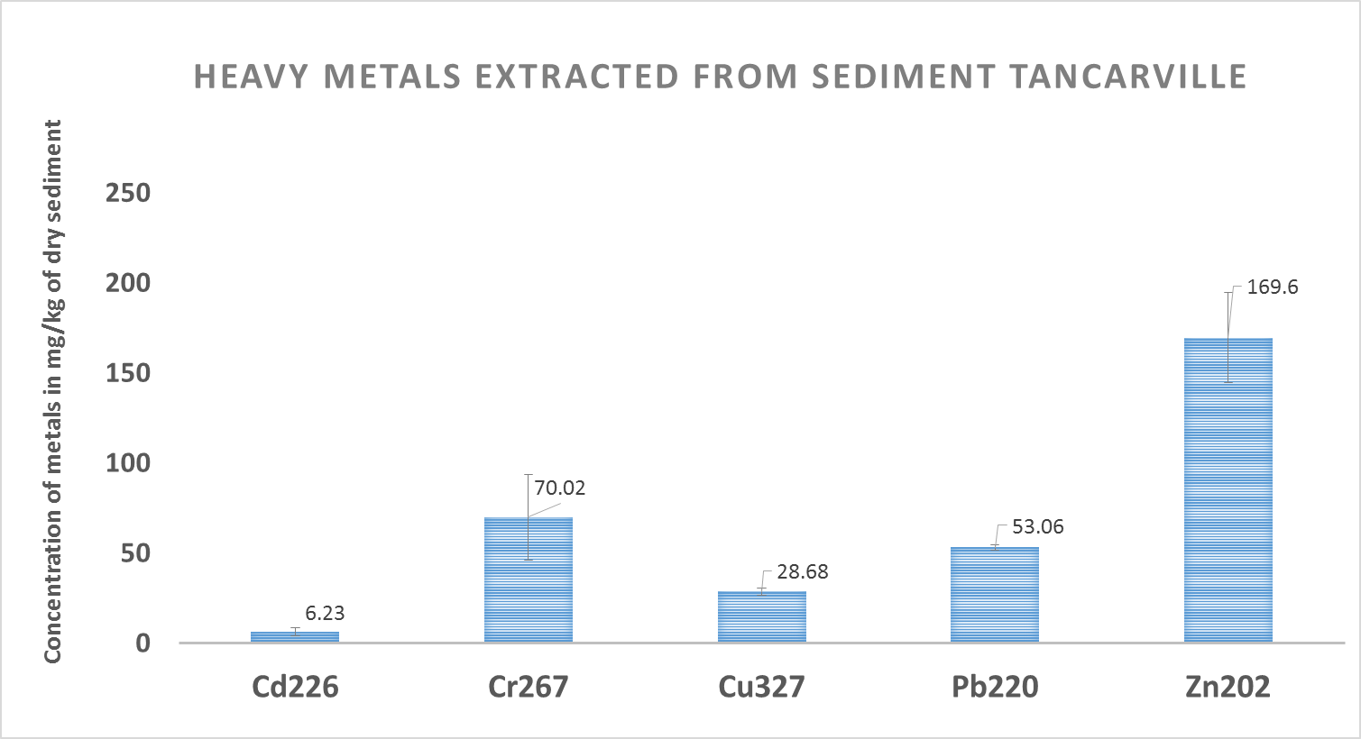
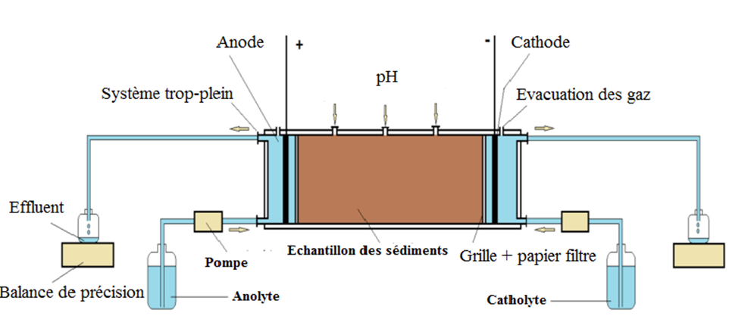
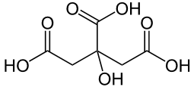
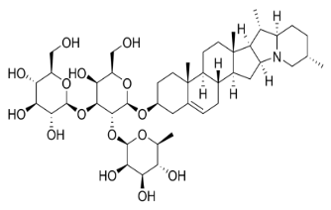
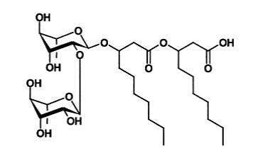
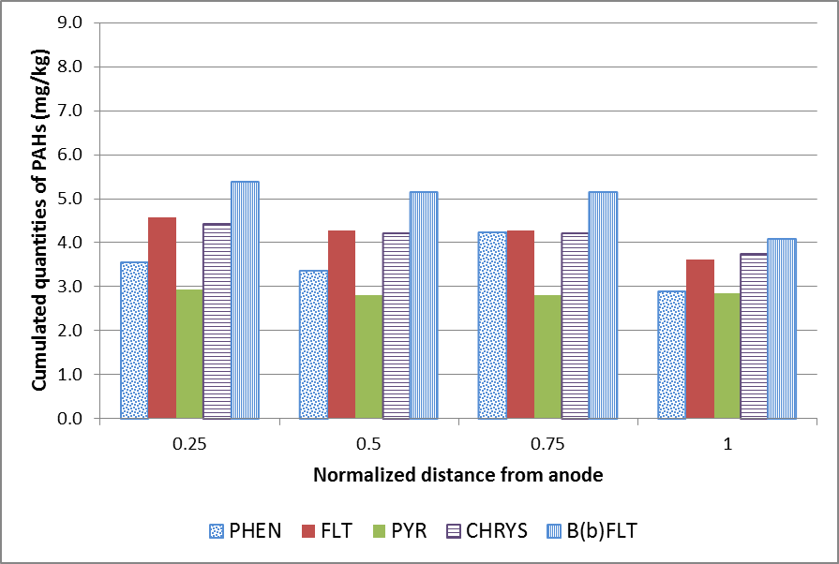
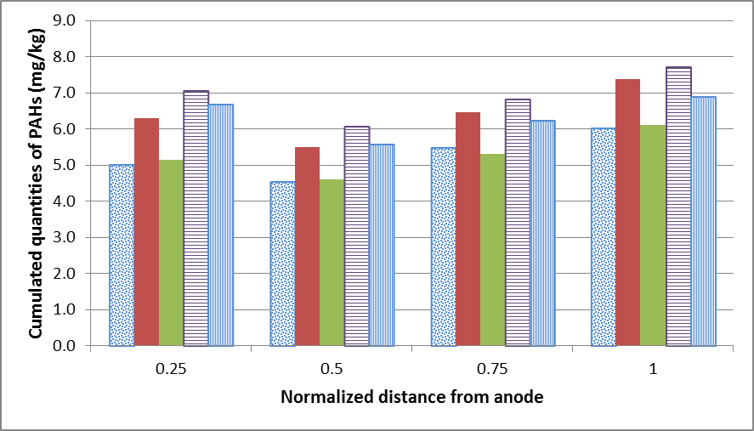
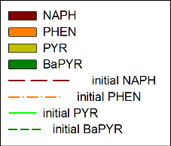
Are biosurfactant and chelating agent mixtures good additives for electro-kinetic remediation of multi-contaminated sediments?
Y. Tian^{1,2}, F. Portet-Koltalo¹, A. Benamar², C. Boulangé-Lecomte³
Laboratory COBRA UMR CNRS 6014, University of Rouen, 55 rue Saint Germain, 27000 Evreux, France. Yue.tian@etu.univ-lehavre.fr
Laboratory LOMC UMR CNRS 6294, University of Le Havre, 53 rue Prony, 76058 le Havre, France. 3 Laboratory SEBIO UMR I02, University of Le Havre, 25 rue Philippe Lebon, 76058 Le Havre, France
Why this study ?
Many organic pollutants such as PAHs, PCBs and metal contaminants are cumulated in dredged sediments which are immobilized in deposit areas with no possible valorization.
Specially, the sediment of Seine River at Tancarville (Normandy, France) is rich in clay, carbonates and organic matters which make the sediment difficult to be treated for remediation.
Consequences:
Damage to aquatic ecosystems, possible transfers (groundwater)
Toxic for living organisms including human-beings
Aims of researches :
Enhancing electro-kinetic remediation
Using combinations of biodegradable surfactants and chelating agents
Sediment information
Harbor dredged sediments
Rich in clay, carbonates (pH_{sediment}=8.4) and organic matter (OM∼6%)
High retentive power for metals (clays) and organic contaminants (OM)
Buffer effect (carbonates) : Reduce metal mobility
Heavy metals extracted from Tancarville sediment
> Level 1 (GEODE)
> Level 2 (GEODE)
Electro-kinetic remediation
Tests with a chelating agent and a surfactant
Advantages:
For low permeability sediment
Multi-decontamination
Fast
Site implementation
Difficulties: suitable efficient additives
Maintain pH: acid
Solubilize lipophilic compounds
Transport heavy metals
Environmentally friendly treatment
12-days treatment : Mixing citric acid + Rhamnolipid (biosurfactant)
(periodic voltage: 5 days on/2 days off, energy savings)
Evacuation of gas
Electroosmotic flow
(EOF) +
Balance
Pump
Sediment sample
Enhancing Additives
2 dominant processes :
Electro migration
Electro osmose
Citric acid
Biosurfactants
Non toxic, Biodegradable
Solubilize PAHs, PCBs, etc.
Objective:
Desorb, solubilize the pollutants in sediment pores and transport them toward the electrodes by applying an electric field (1 V/cm)
Saponin
“Flush” effect of periodic voltage on I : not very pronounced
Acid maintenance successful
But pH> pKa_{Rhamnolipid} ~ 4.8, Rhamnolipid: anionic → migrate s to anode (opposed to EOF) detrimental for removing organics?
Good chelating agent
Maintain pH ≈ 4
Natural molecule
anionic
Rhamnolipid
nonionic
Anionic or nonionic surfactants ?
Citric acid + nonionic Tween 20 or Citric acid + anionic SDS, 12 days treatment
Citric acid + Tween 20
Citric acid + SDS
PAHs, PCBs: migrate from middle to anode
poor removals for PAHs
no removals for PCBs
Problem with the anionic biosurfactant?
Heavy metals: migration only begins
Poor removals (1-18%)
Not enough time to migrate more to the electrodes?
Citric acid + Tween 20: better removals for PAHs
Anionic surfactant SDS moves against EOF detrimental for removing organics
24-days treatment : Citric acid + Rhamnolipid or viscosin-like biosurfactants
(periodic voltage: 5 days on/2 days off, energy savings)
Possible improvements Conclusion
PAHs remediation by 2nd treatment
Testing saponin (nonionic biosurfactant) instead of rhamnolipid
Higher saponin concentration (biodegradability: regular renewal)
Longer treatment time for clay and carbonate rich sediments
Mixtures of biodegradable chelating agents + biosurfactants
Promising candidates for EK multi-decontamination
“Flush” effect of periodic voltage on I : more important
PAHs depletion at cathode side
Better removals (-25%)
Heavy metals:
Cd, Pb, Zn: better removals than 1st test (11-34%)
Need longer-time treatment

